Slide 1

Governance and Compliance with Microsoft Purview A getting started guide – Unified catalog
If you think compliance is complicated, feel free to try incompliance!
Jan Cordtz, Snr. Cloud Solution Architect
Microsoft Denmark
Note – in this document the name Purview – if not otherwise
stated - is used for the Data Governance part of Purview.

Slide 2
Get Purview Data Governance running

Slide 3
The Purview “Process”
Installation
Establish Domains
Data Map
Unified Catalog
Establish Governance Domains
Establish Collections
Establish Data Products
Register Sources
Connect assets to Data Products -> Governed assets
Establish assets
Scan
API
Enhance assets
Descriptions (scan?)
Owners
Lineage (scan?)
Glossaries
Classification (scan?)
Sensitivity
Enhance data product
Owners
Glossaries
OKR
Critial Data elements
Data Access
Advanced
Api’s
Workflows
Enforcement of rights

Slide 4
Establish the Unified Catalog
Unified Catalog

Slide 5
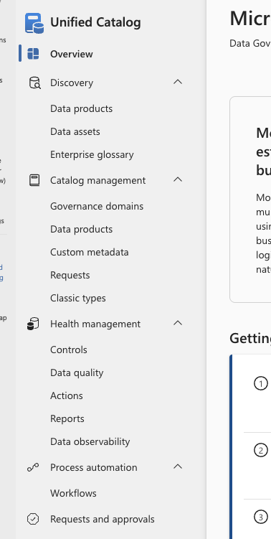
The Unified Catalog Purview menu
Discovery contains the search options for Purview. Note that data assets from the Data Map is in this menu part
Under Catalog management you will find what is the
Unified catalog and its content.
Health management has the reporting and quality items for
the Unified catalog and its content.
Process automation has one item being workflow where you can assign approval workflows etc.
Request and approvals is where you will find any request needed to be handled along with the request already processed.

Slide 6
Discovery
Search capabilities

Slide 7
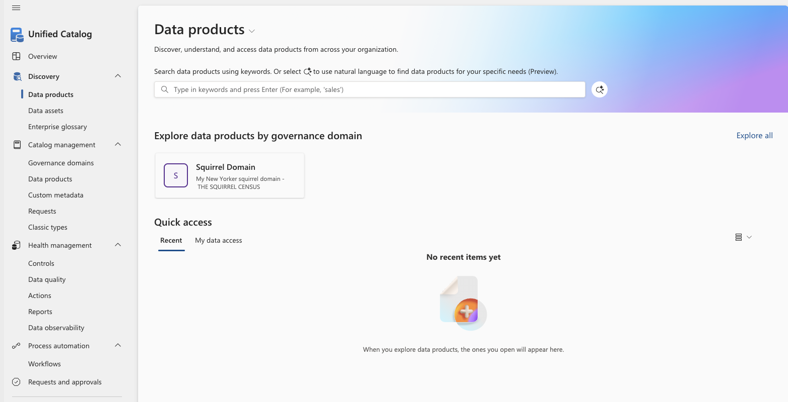
Search – data products
Here you can search your data products.
This can either be done using words,
clicking a published governance domain or
using natural language.
To use natural language, you need to click here.
Clicking a governance domain brings you to the data products in the domain.

Slide 8
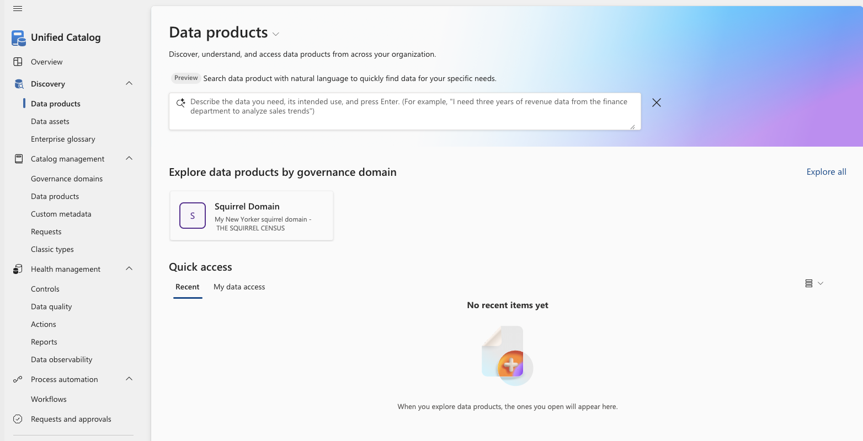
Search – data products – natural language
When using natural language for your search, you formulate in your words what it is your looking for.
So, instead how having an idea about what a data product might be called you instead write what it is you are really looking for.
Example (as shown): I need three years of revenue data from the finance department to analyze sales trends.

Slide 9
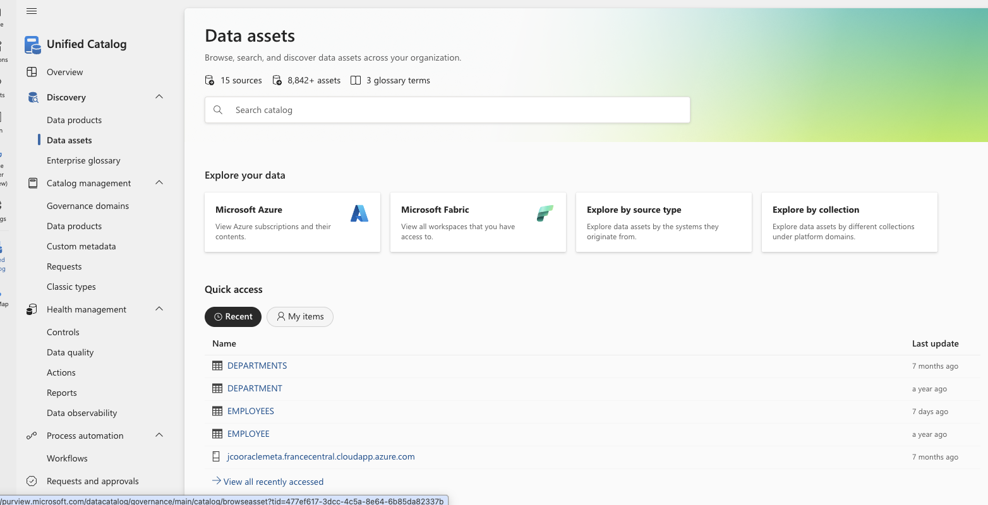
Search – data assets from the data map
The search for data assets is also located in the discovery menu under Unified catalog.
Here you search using words.
You can also click the explore options where you can find assets related to one the following option
Azure
Fabric
Source type
Collection
Purview also show recent found data assets under Quick access.

Slide 10
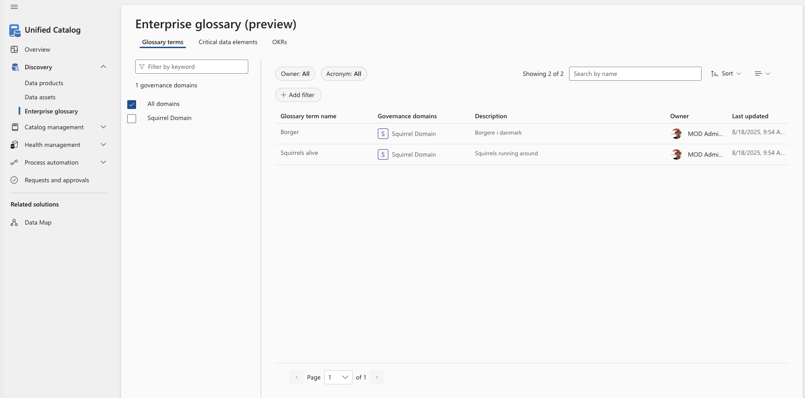
Search – Enterprise glossary – Glossary terms
The Enterprise glossary search provides access to searching glossary terms, critical data elements as well as objectives and key results (OKRs).
This screen show the glossary terms search.
You can add filters or “just” search by the name you are looking for.

Slide 11
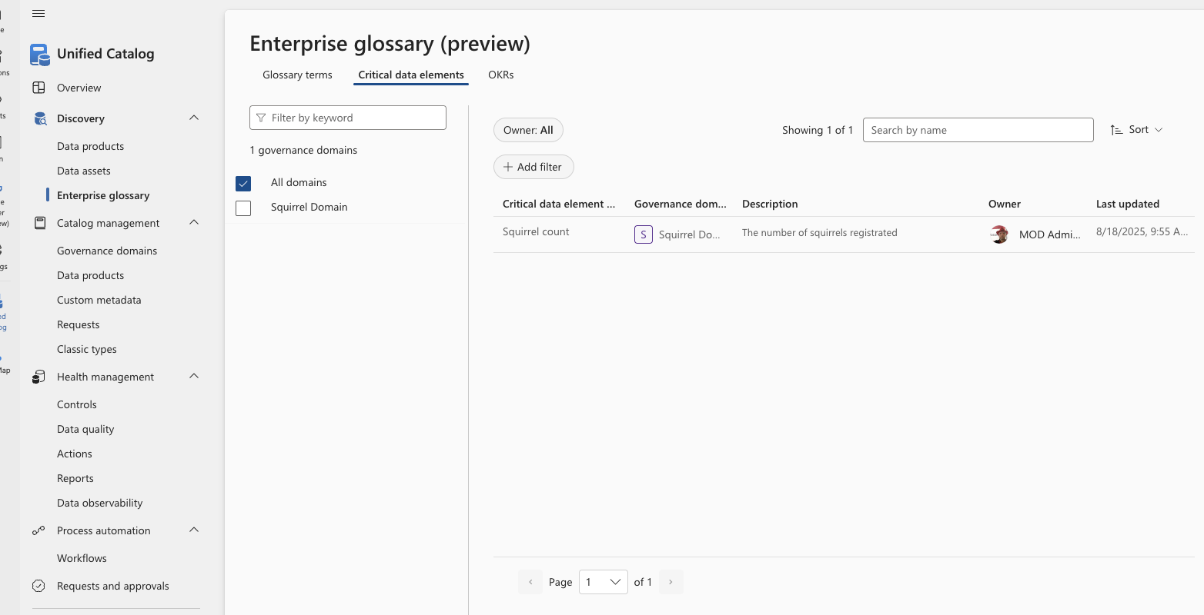
Search – Enterprise glossary – Critical data elements
The Enterprise glossary search provides access to searching glossary terms, critical data elements as well as objectives and key results (OKRs).
This screen show the Critial data elements search.
You can add filters or “just” search by the name you are looking for.

Slide 12
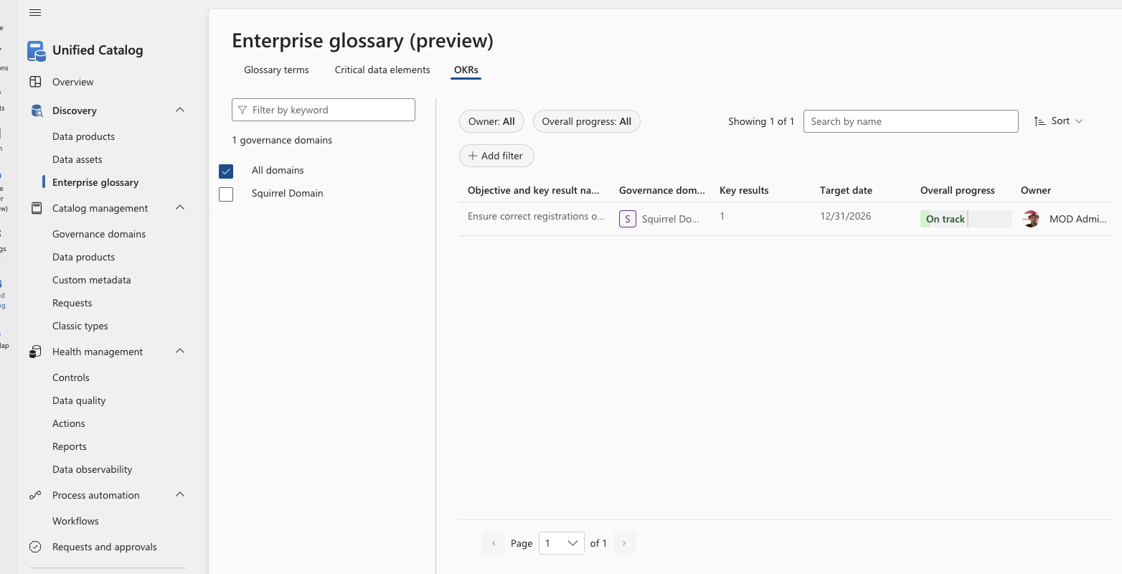
Search – Enterprise glossary – OKRs
The Enterprise glossary search provides access to searching glossary terms, critical data elements as well as objectives and key results (OKRs).
This screen show the objectives and key results (OKRs) search.
You can add filters or “just” search by the name you are looking for.

Slide 13
Catalog management
Governance domains

Slide 15
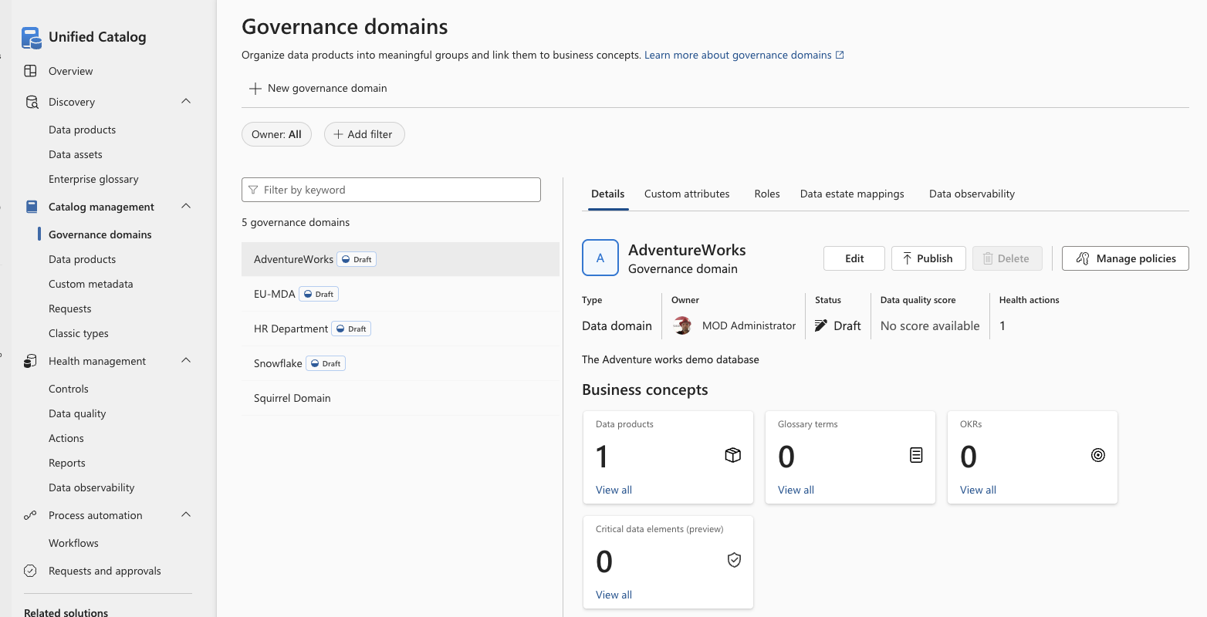

Slide 16
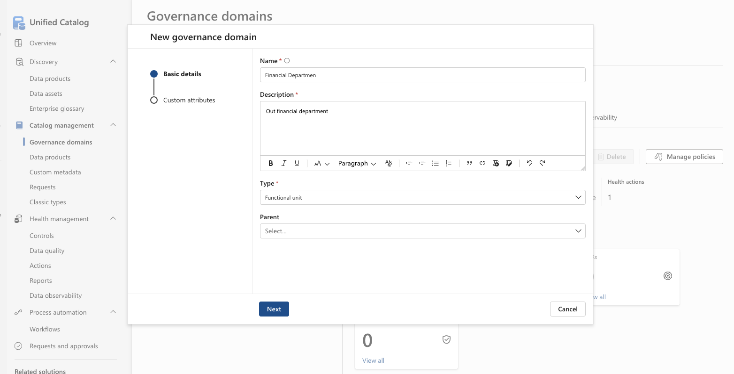
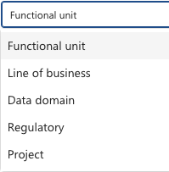

Slide 17
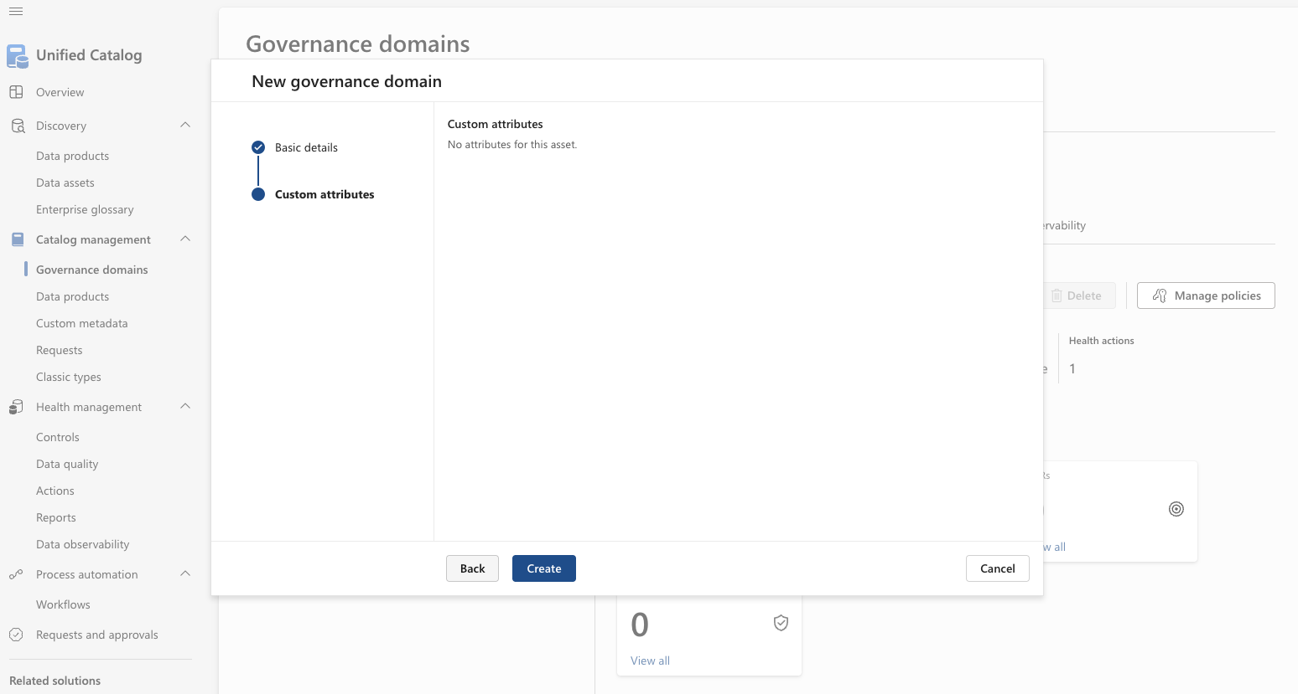

Slide 18
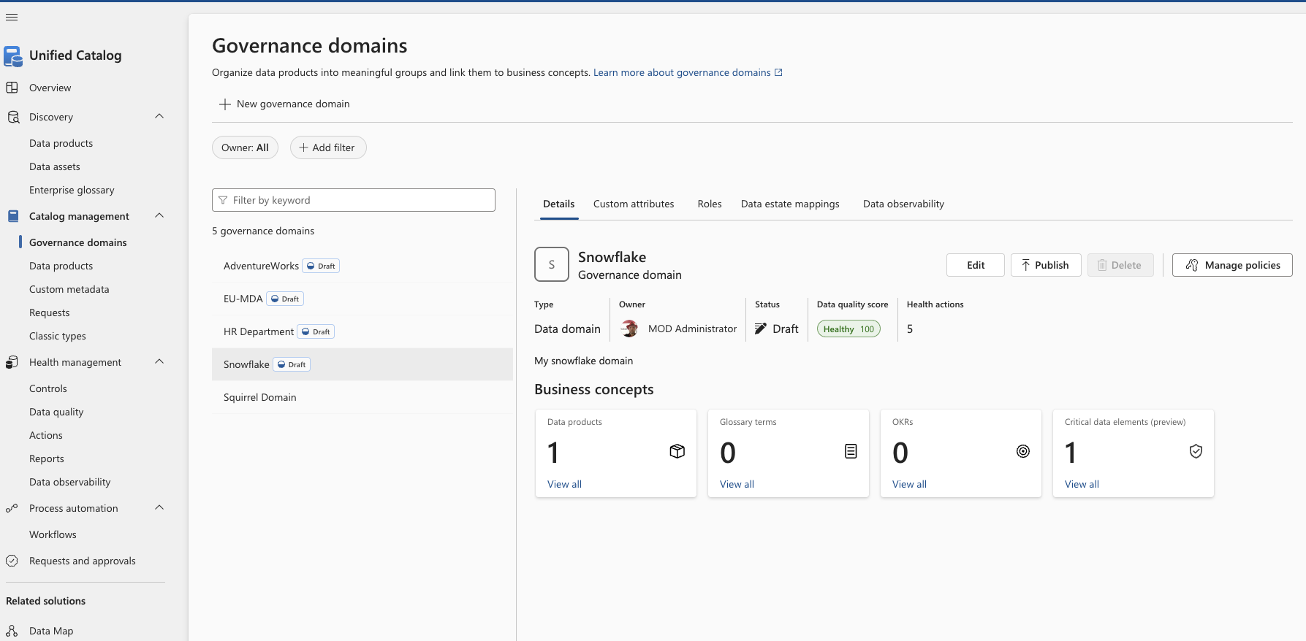

Slide 19
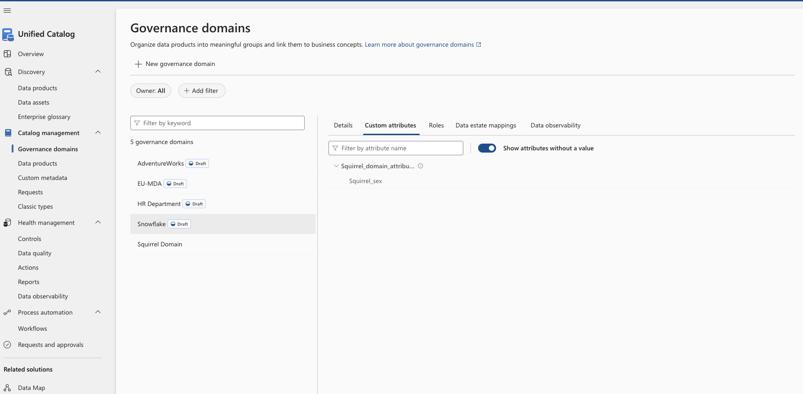

Slide 21
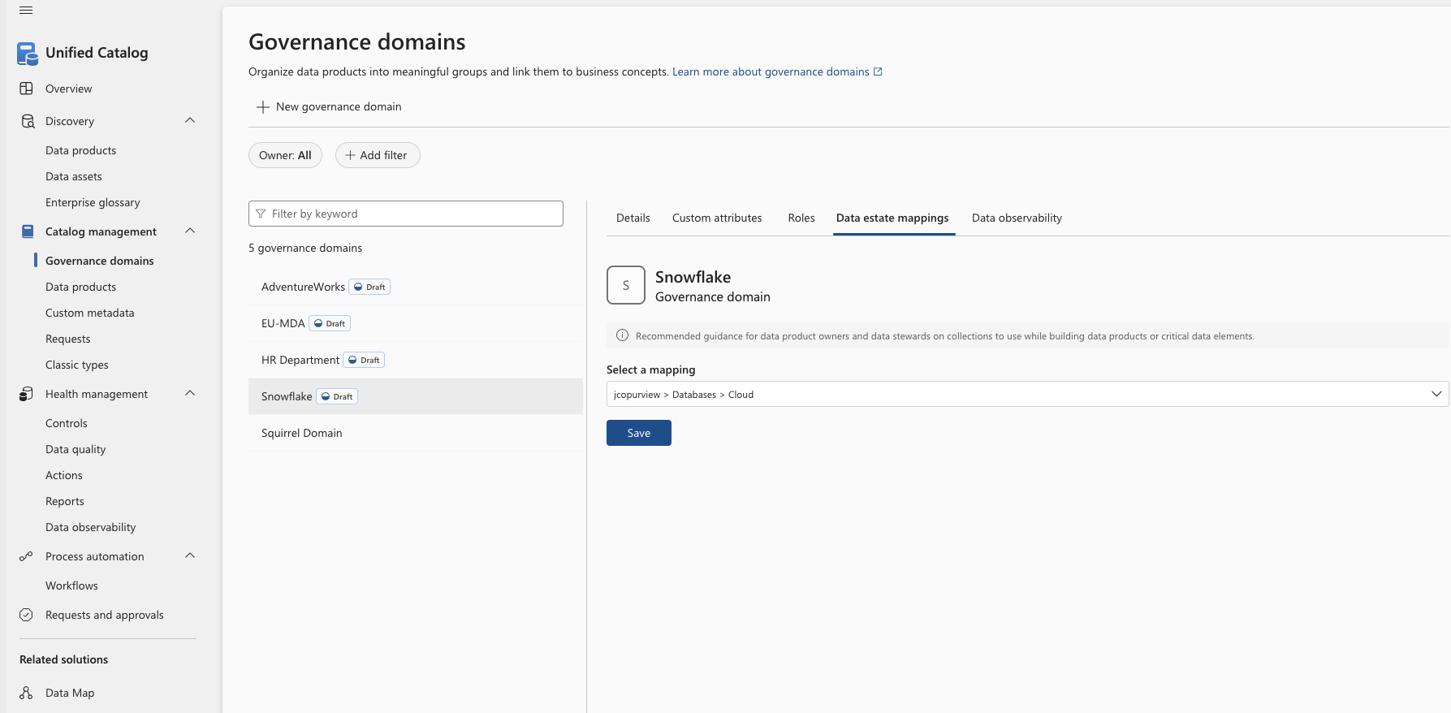

Slide 22
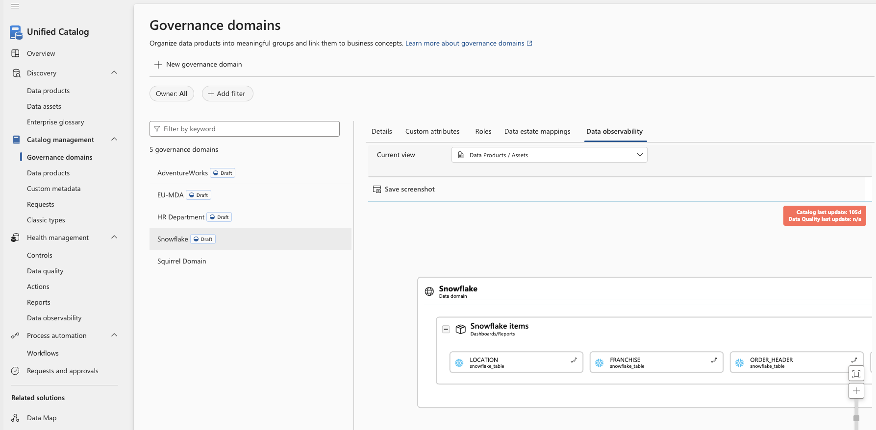

Slide 23
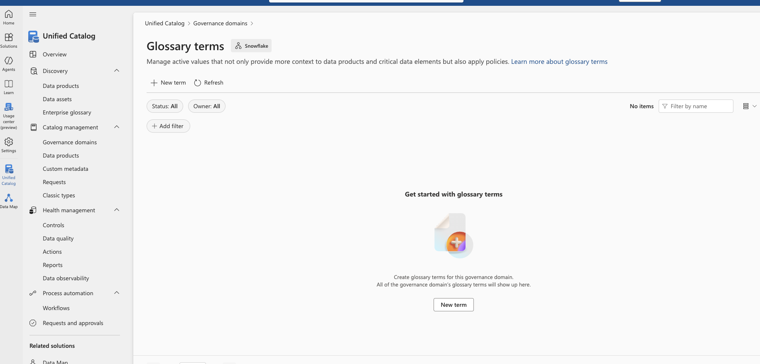

Slide 25
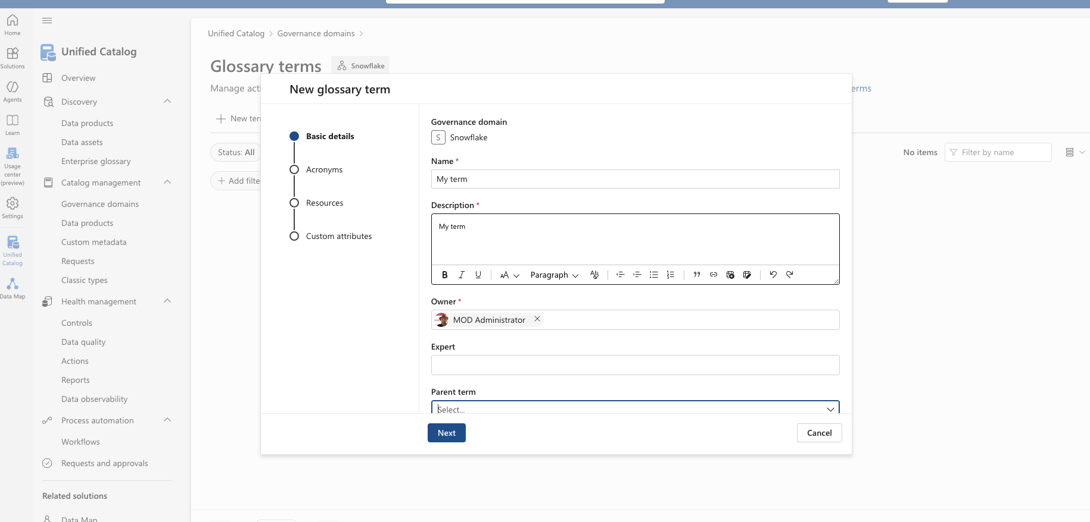

Slide 26
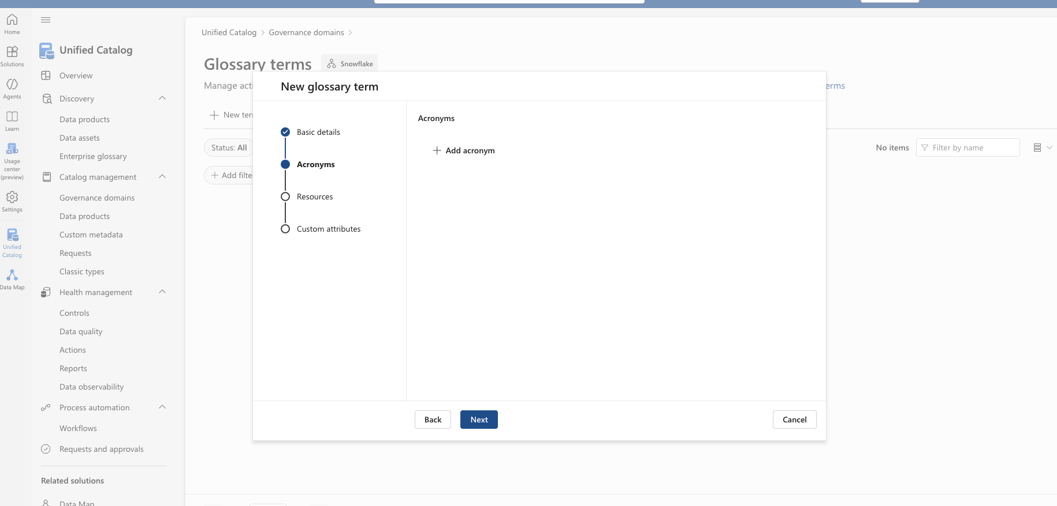

Slide 27


Slide 29
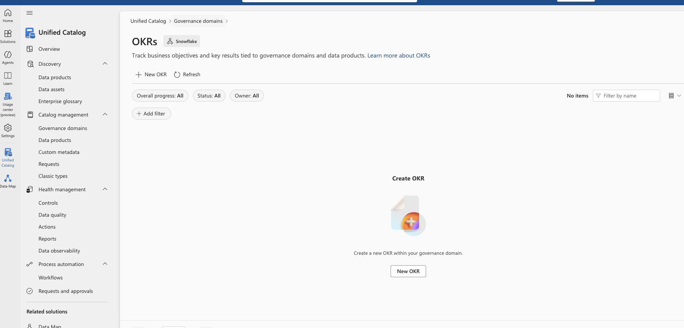

Slide 30
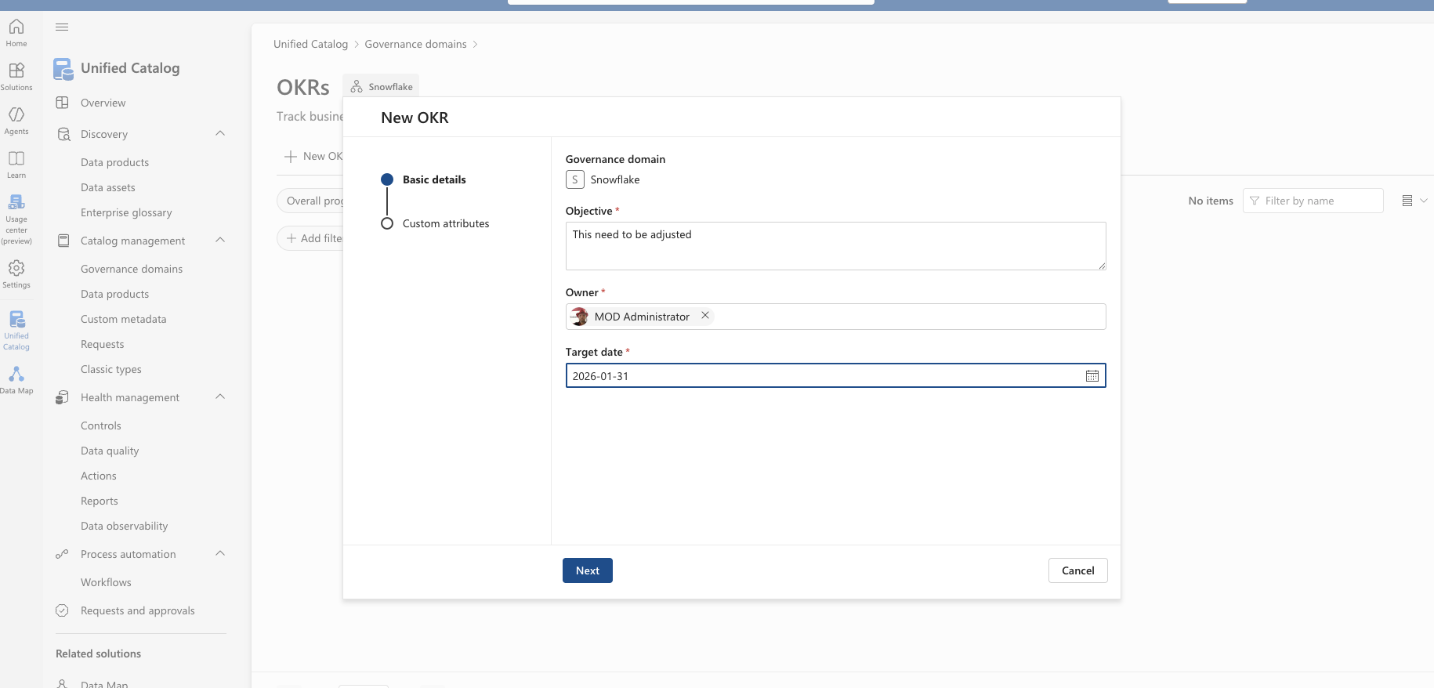

Slide 31
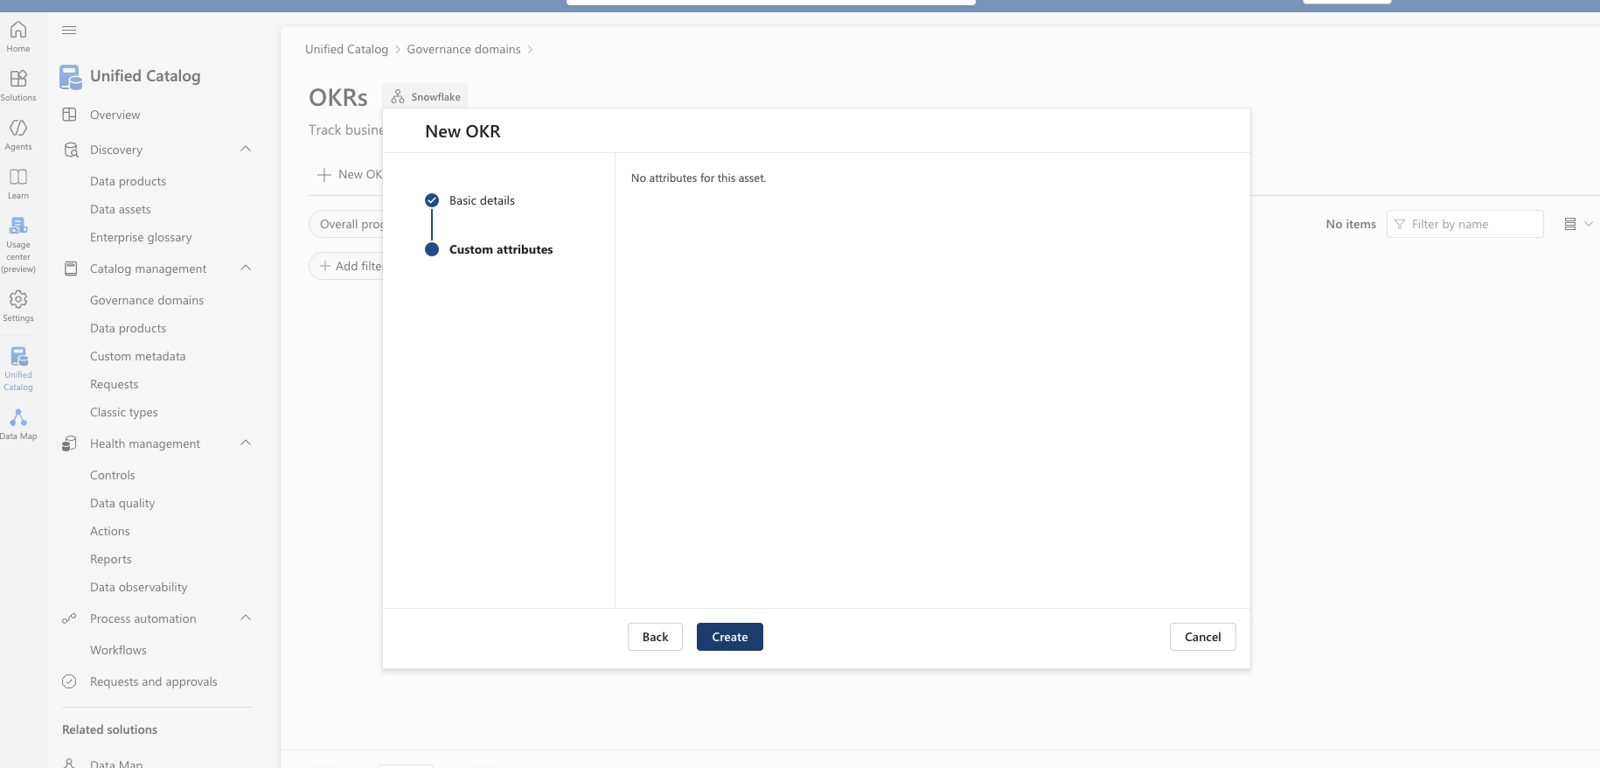

Slide 32
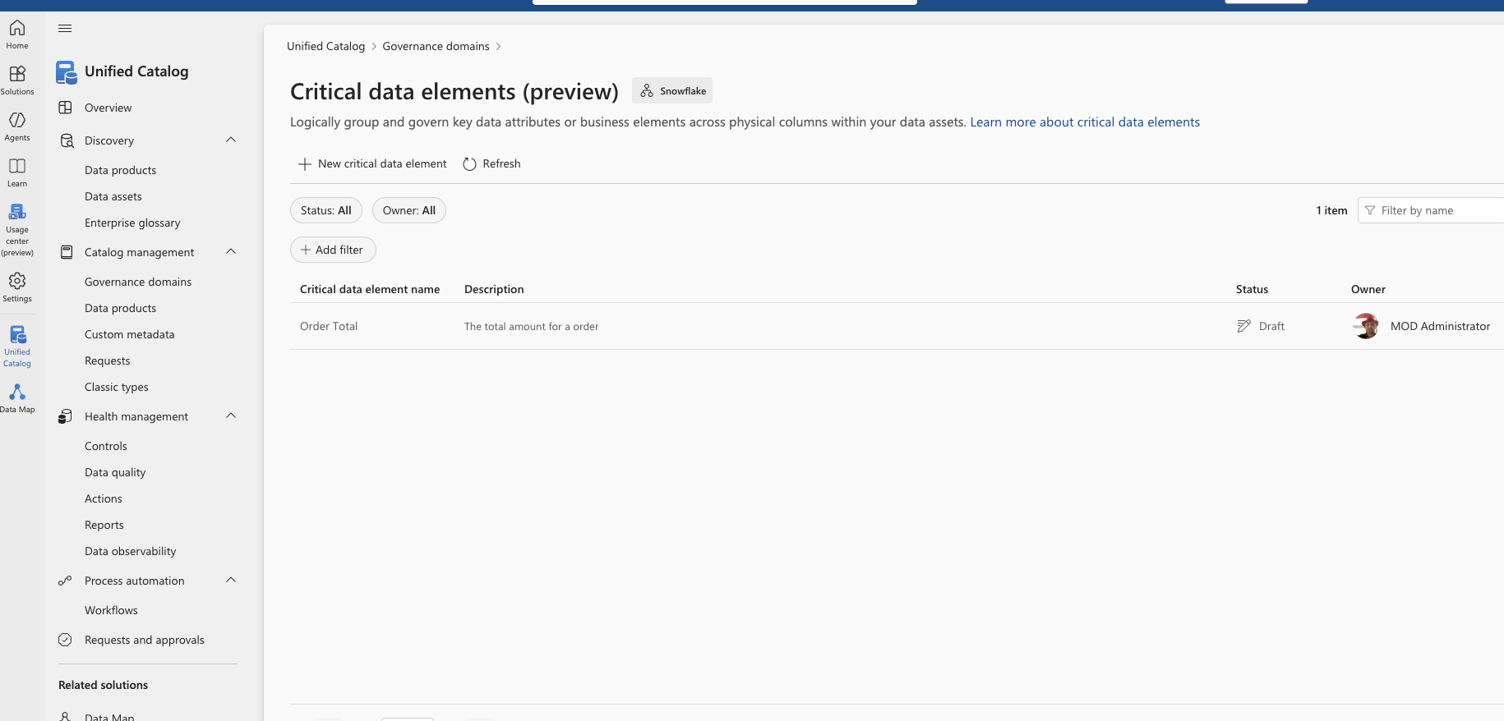

Slide 33
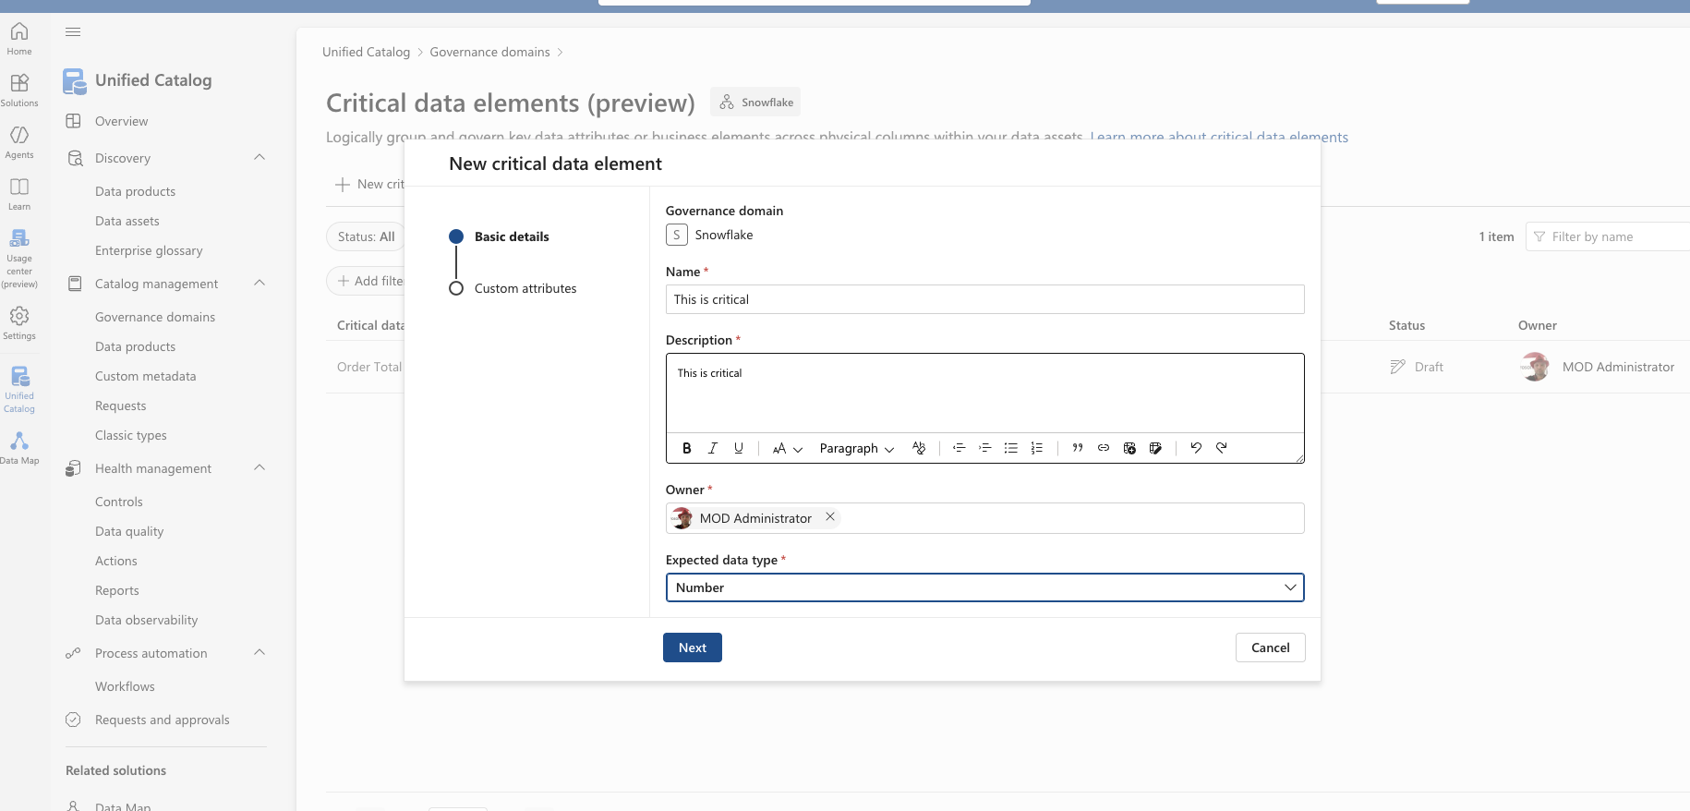

Slide 34
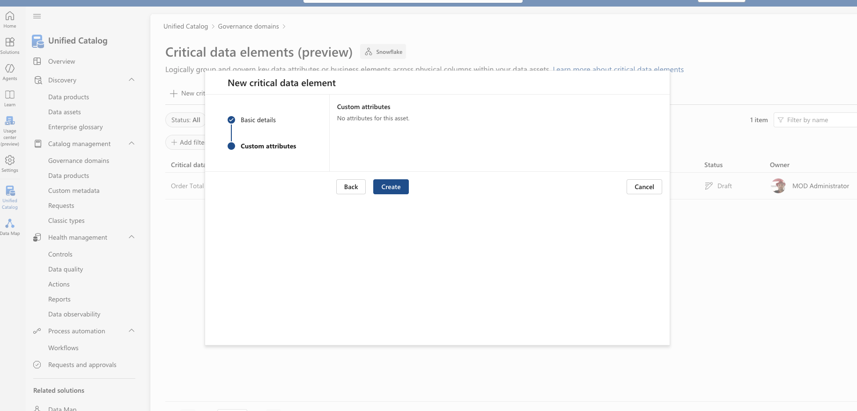

Slide 35
Data products

Slide 36
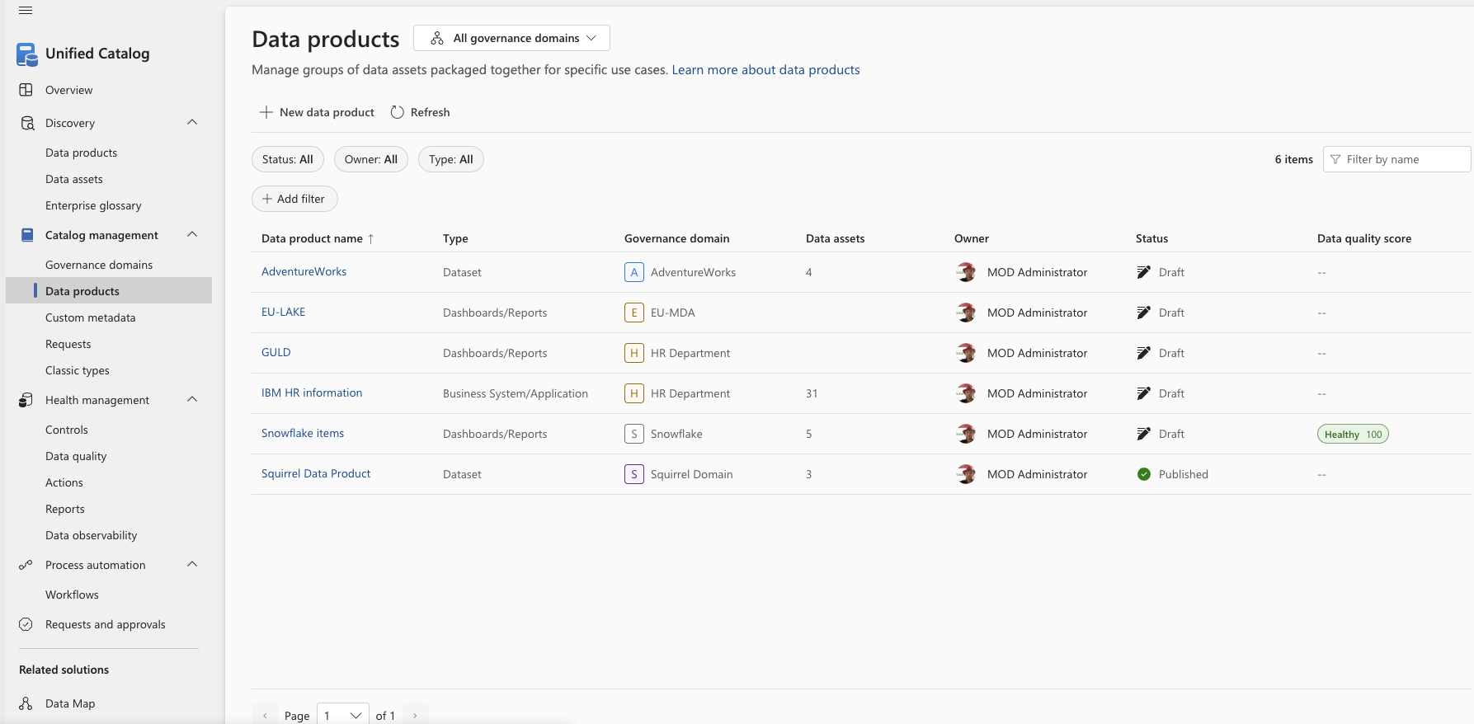

Slide 37
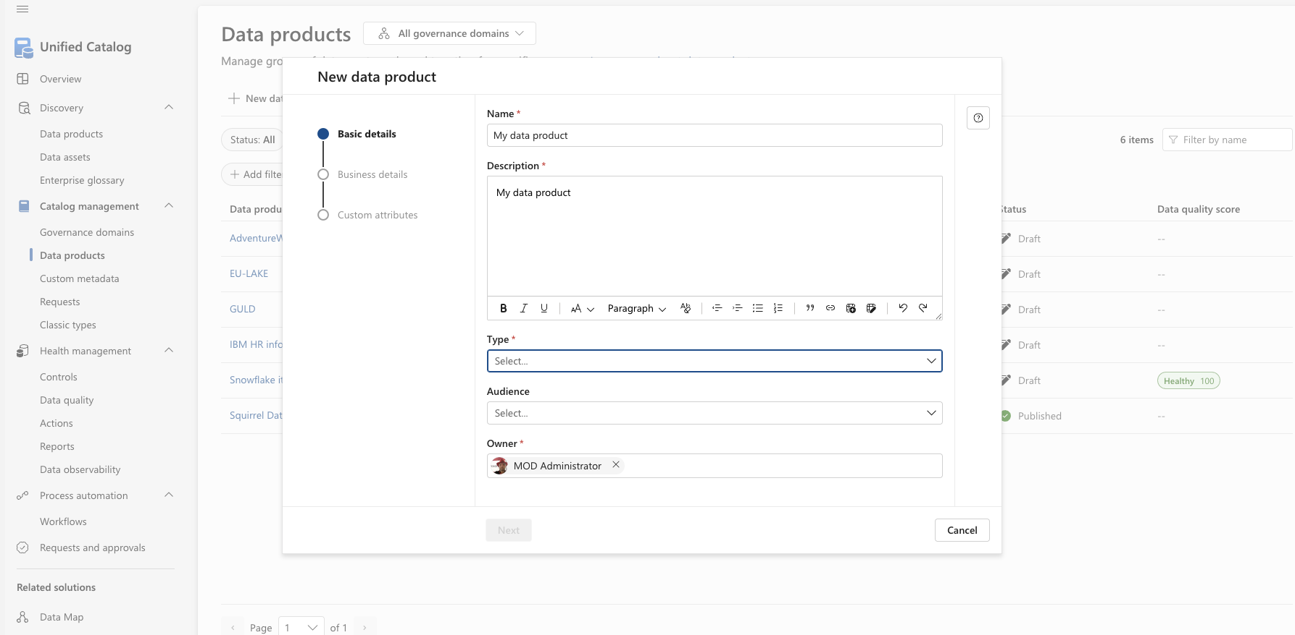

Slide 39
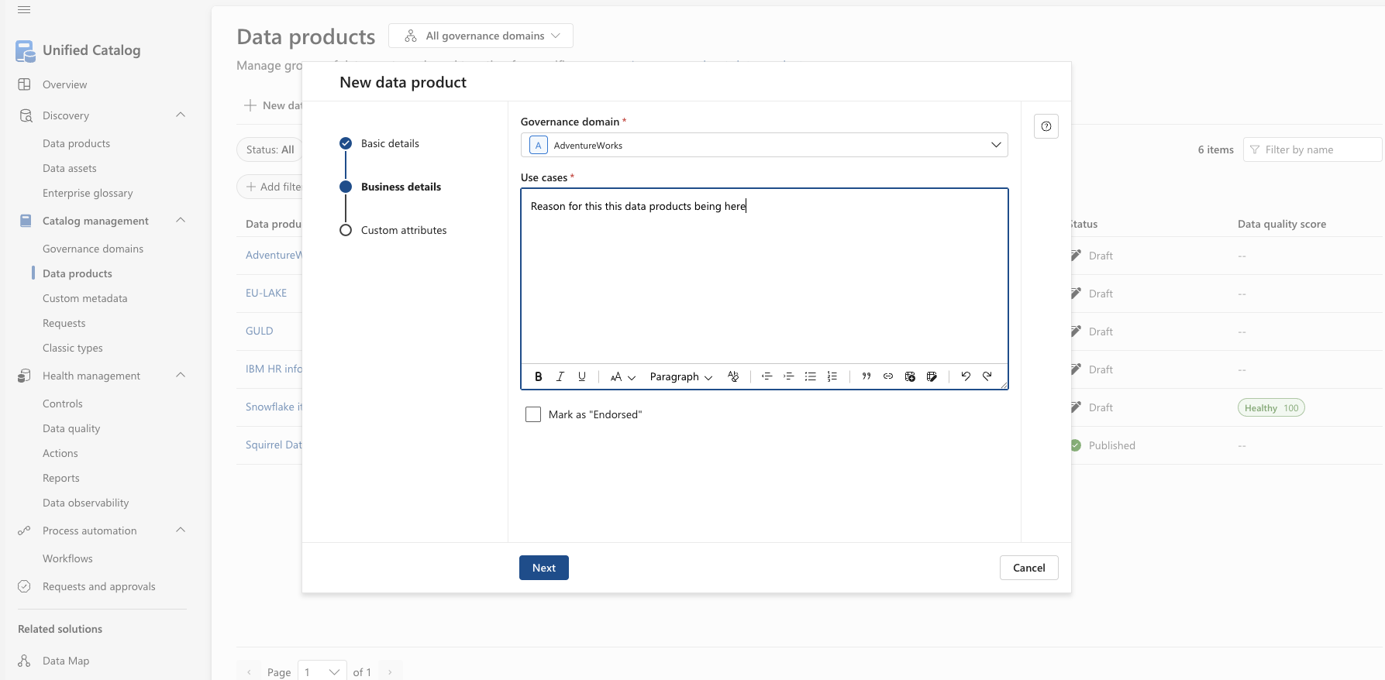

Slide 40
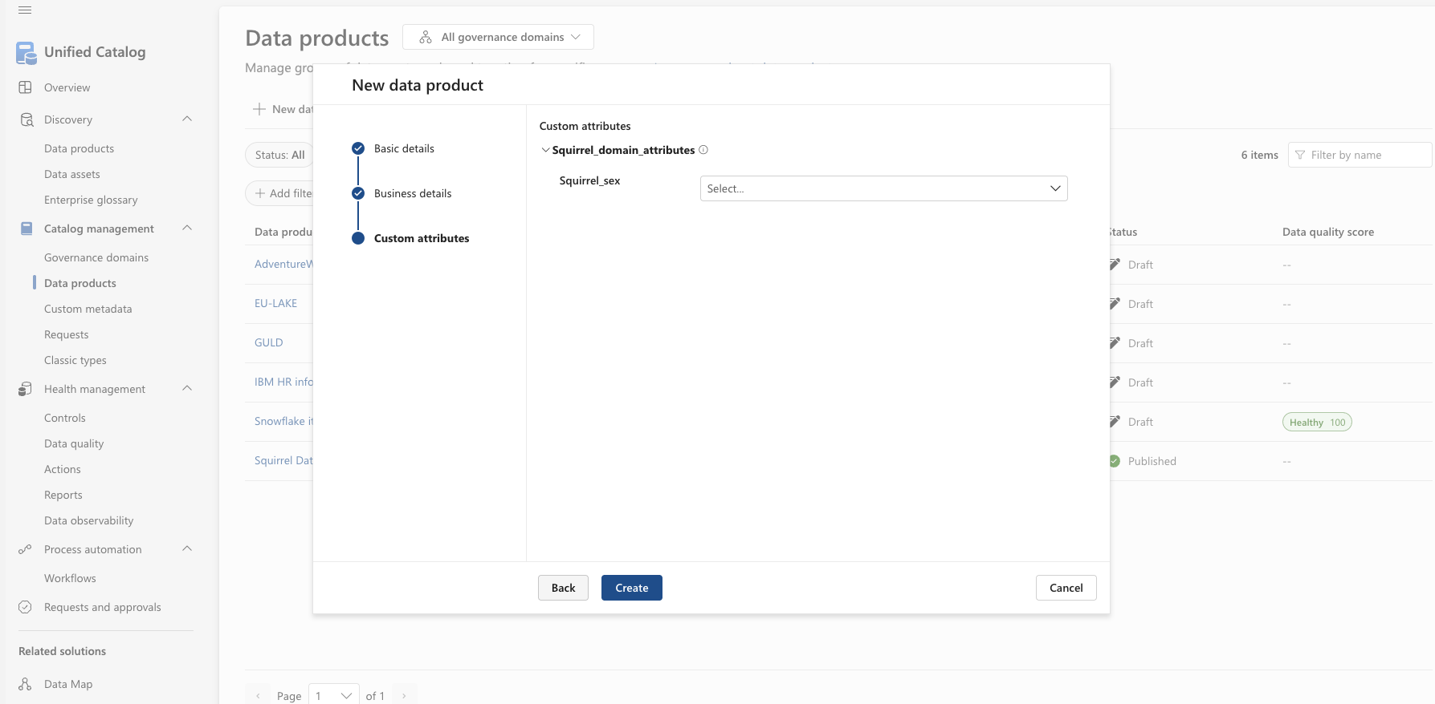

Slide 41
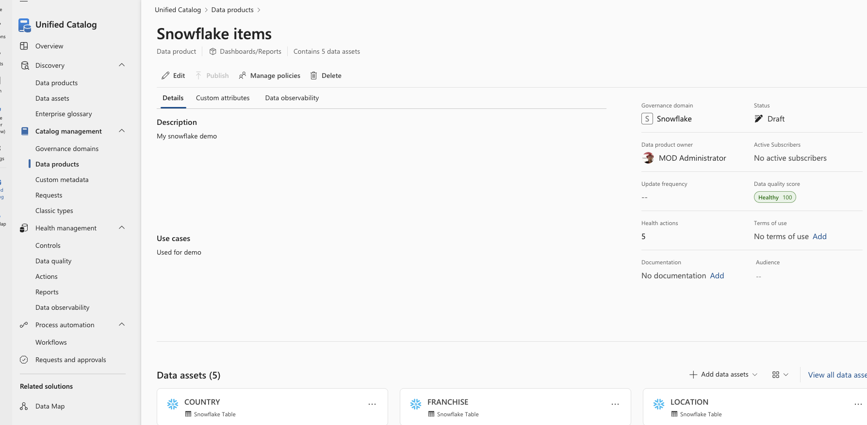

Slide 42
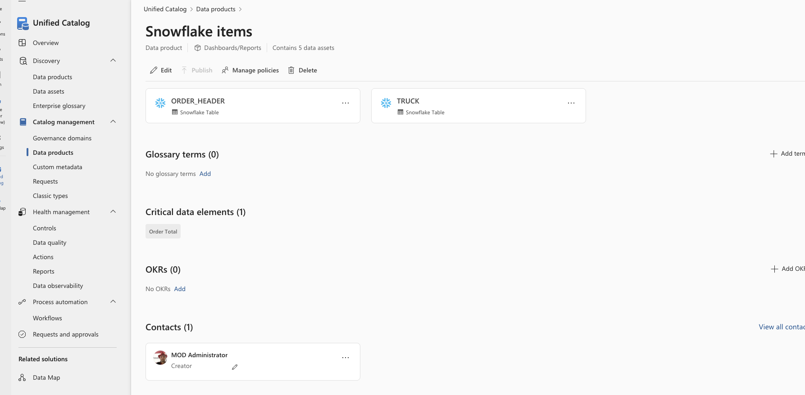

Slide 43
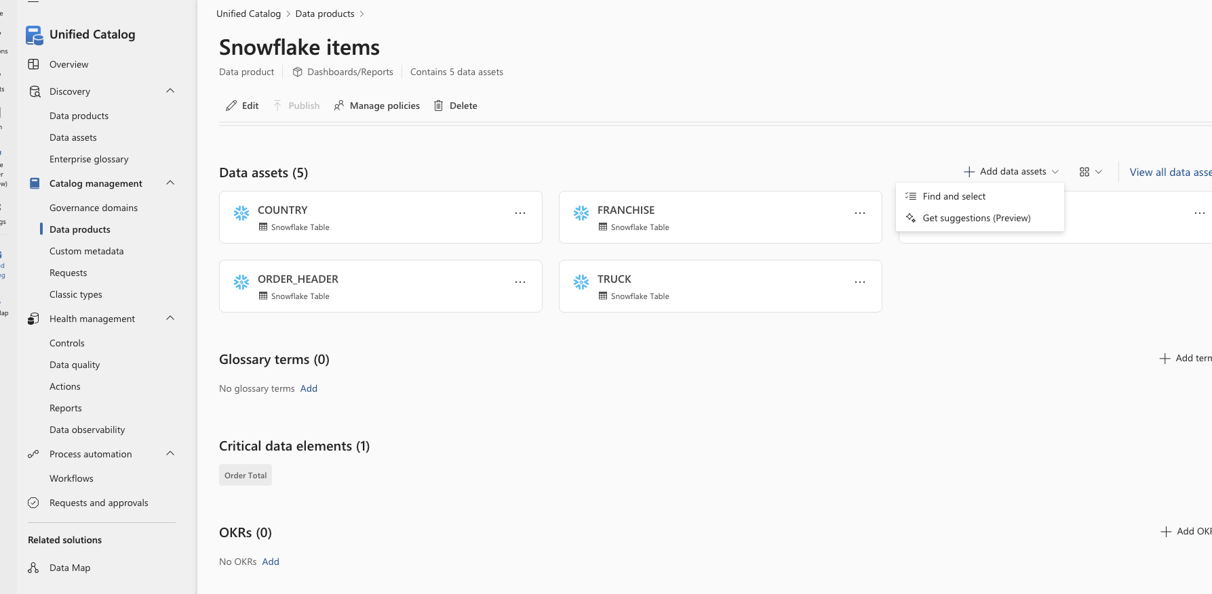

Slide 44
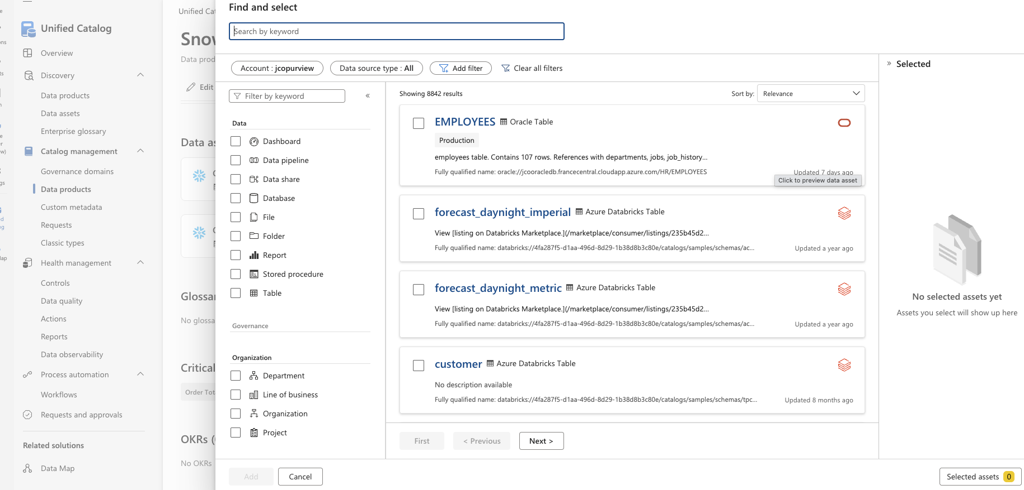

Slide 45
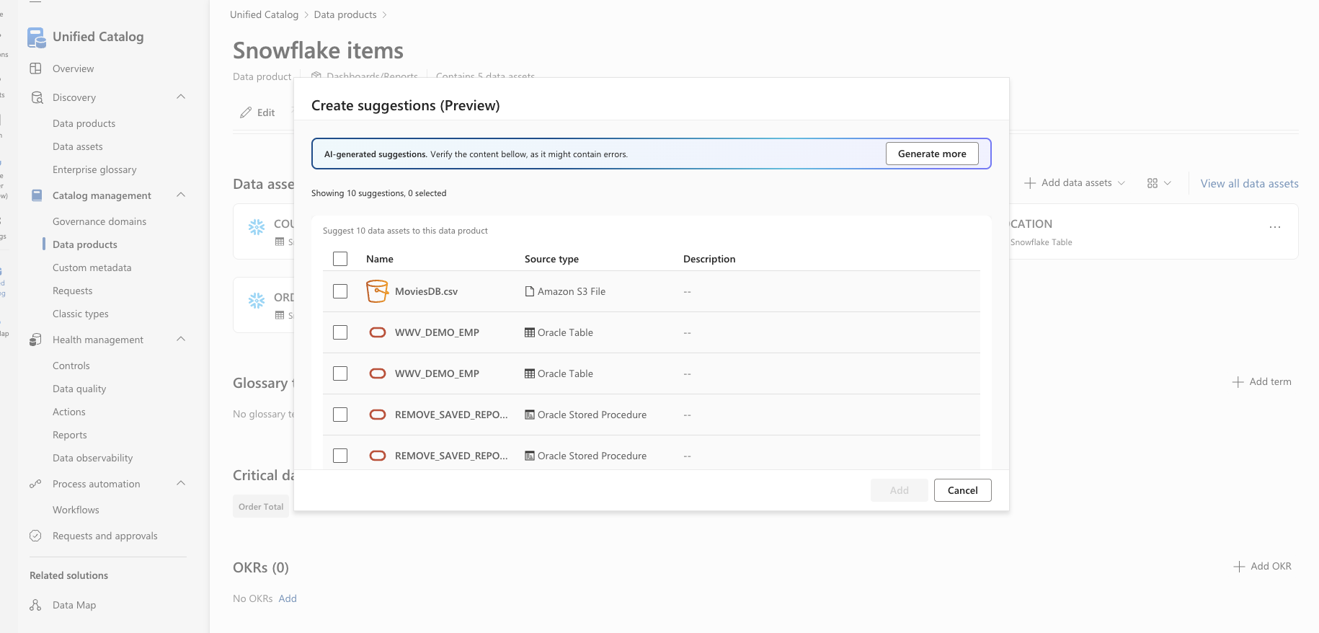

Slide 46
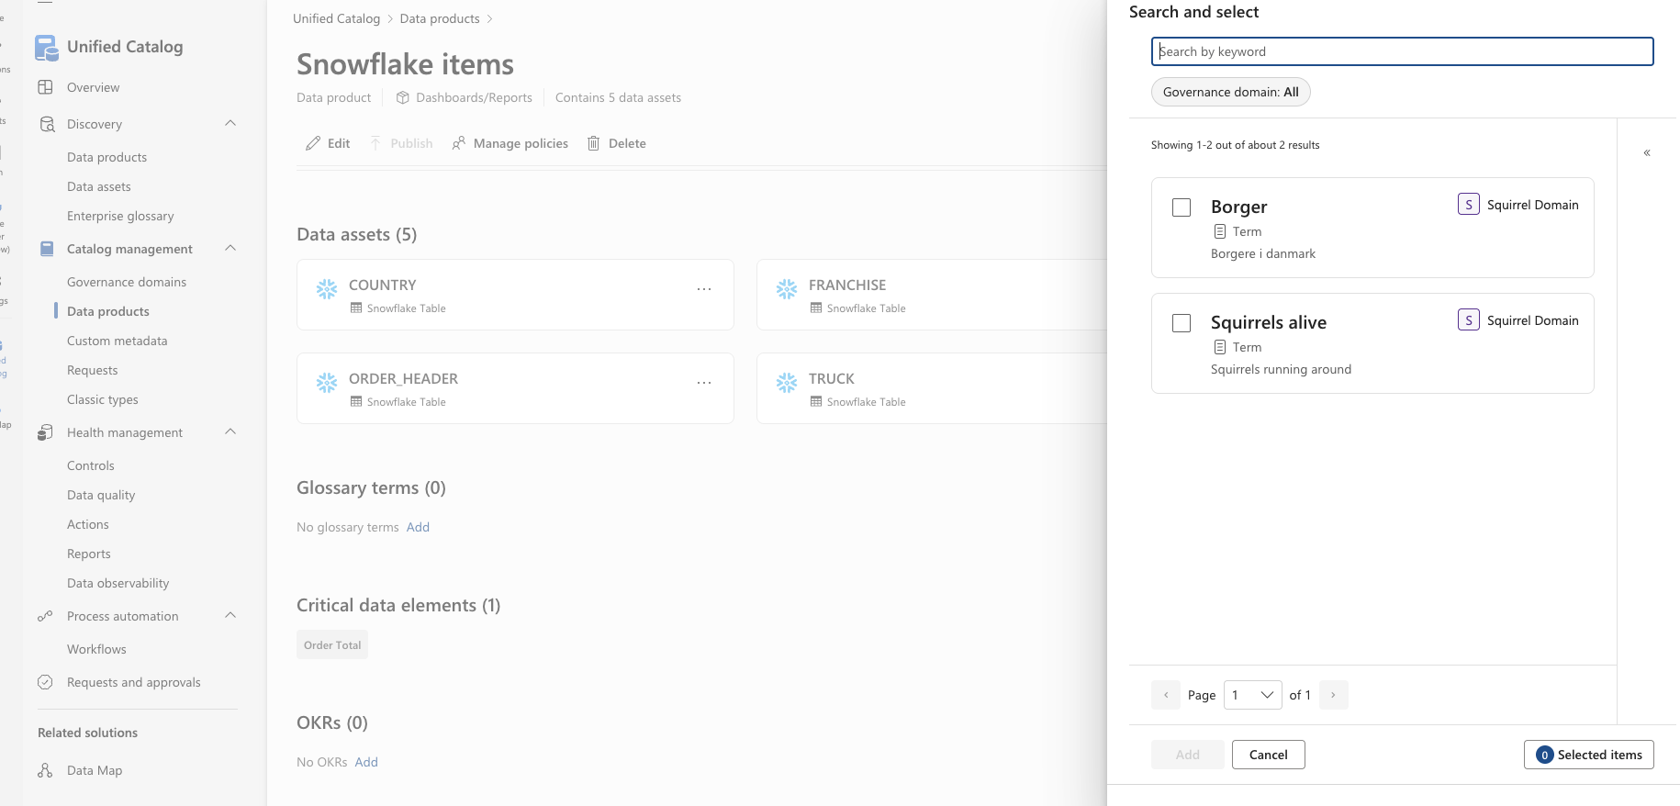

Slide 48
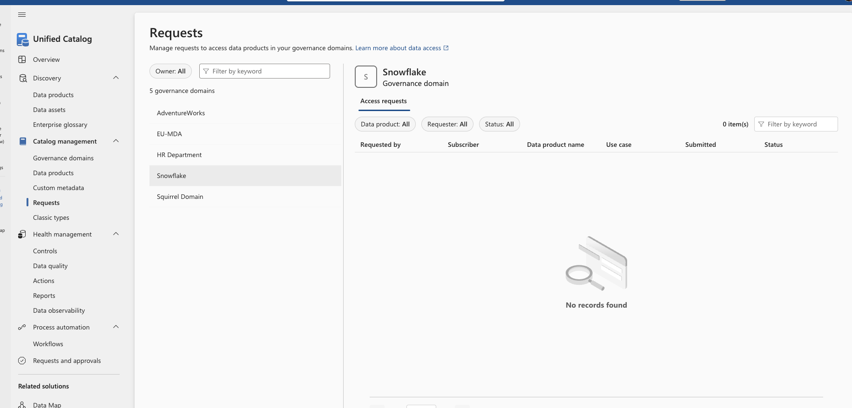

Slide 49
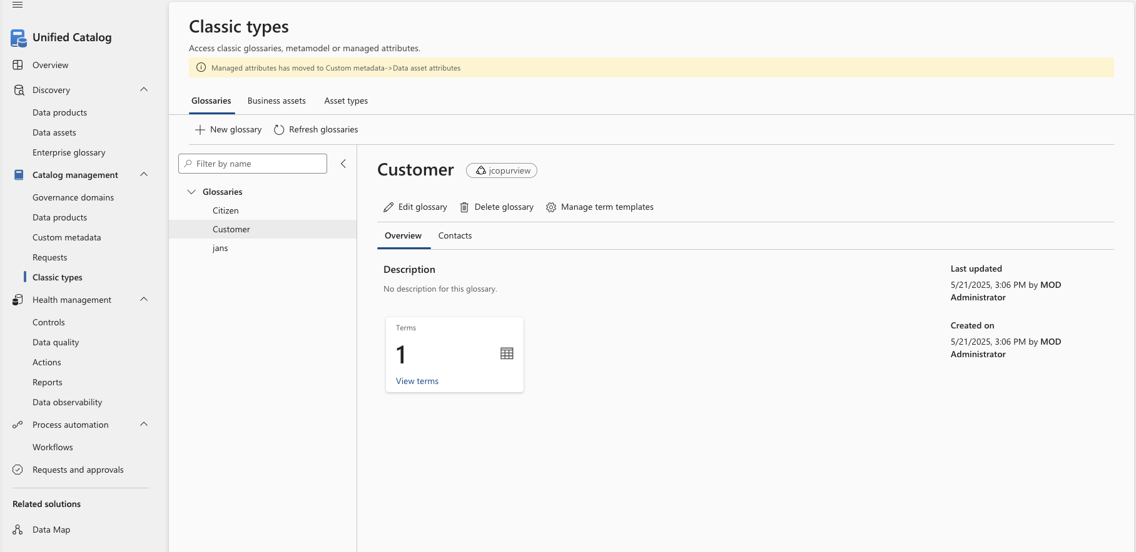

Slide 50
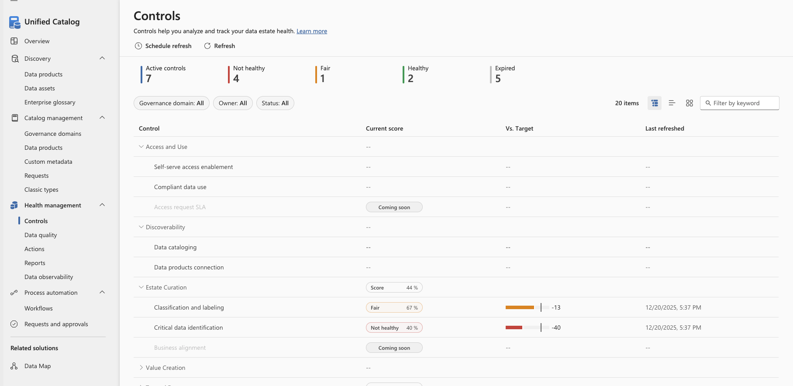

Slide 51
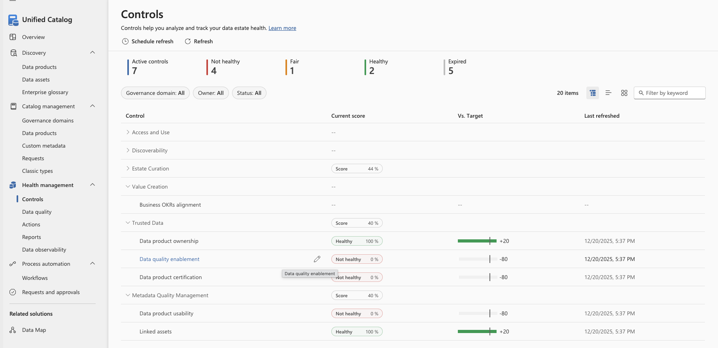

Slide 52
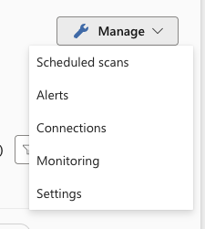
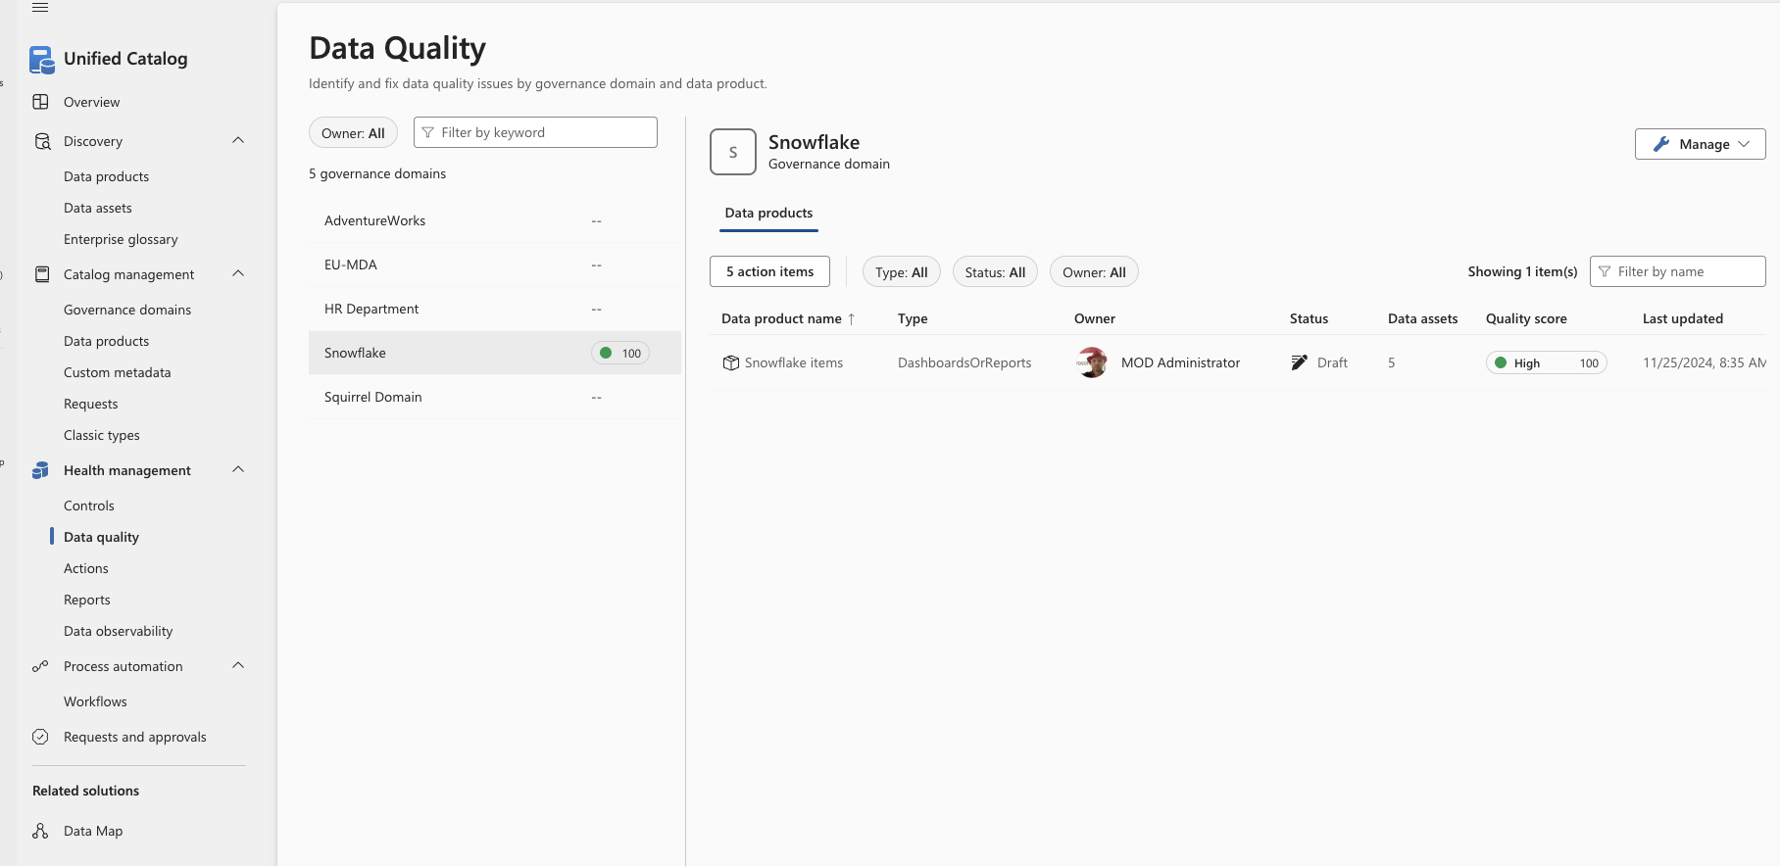

Slide 53
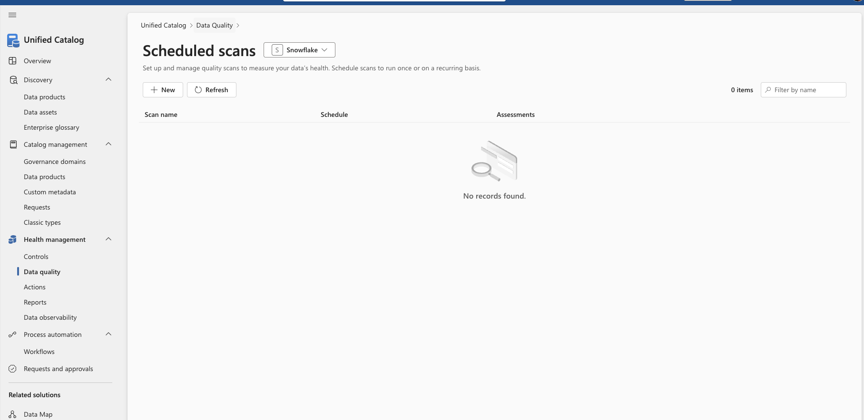

Slide 54
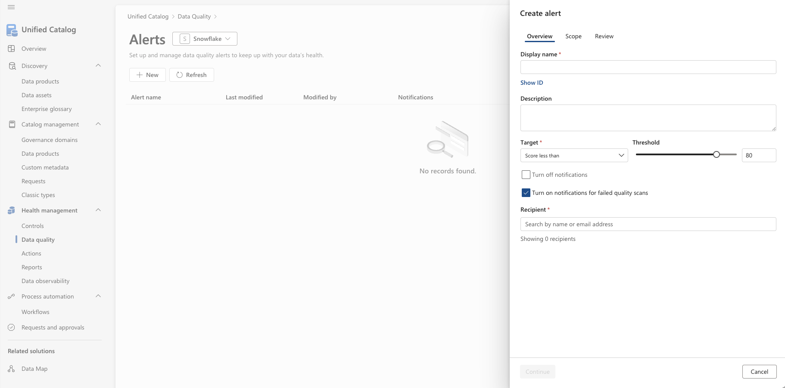

Slide 55
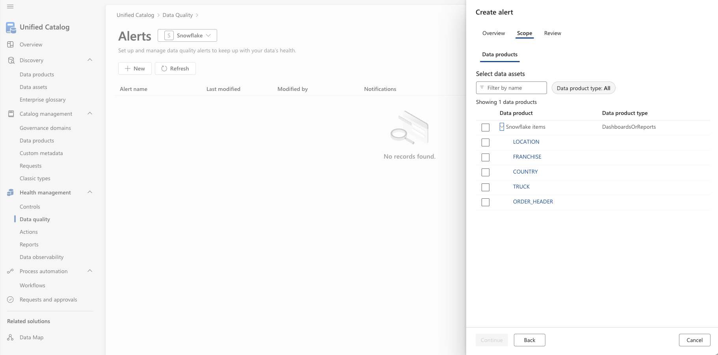

Slide 56
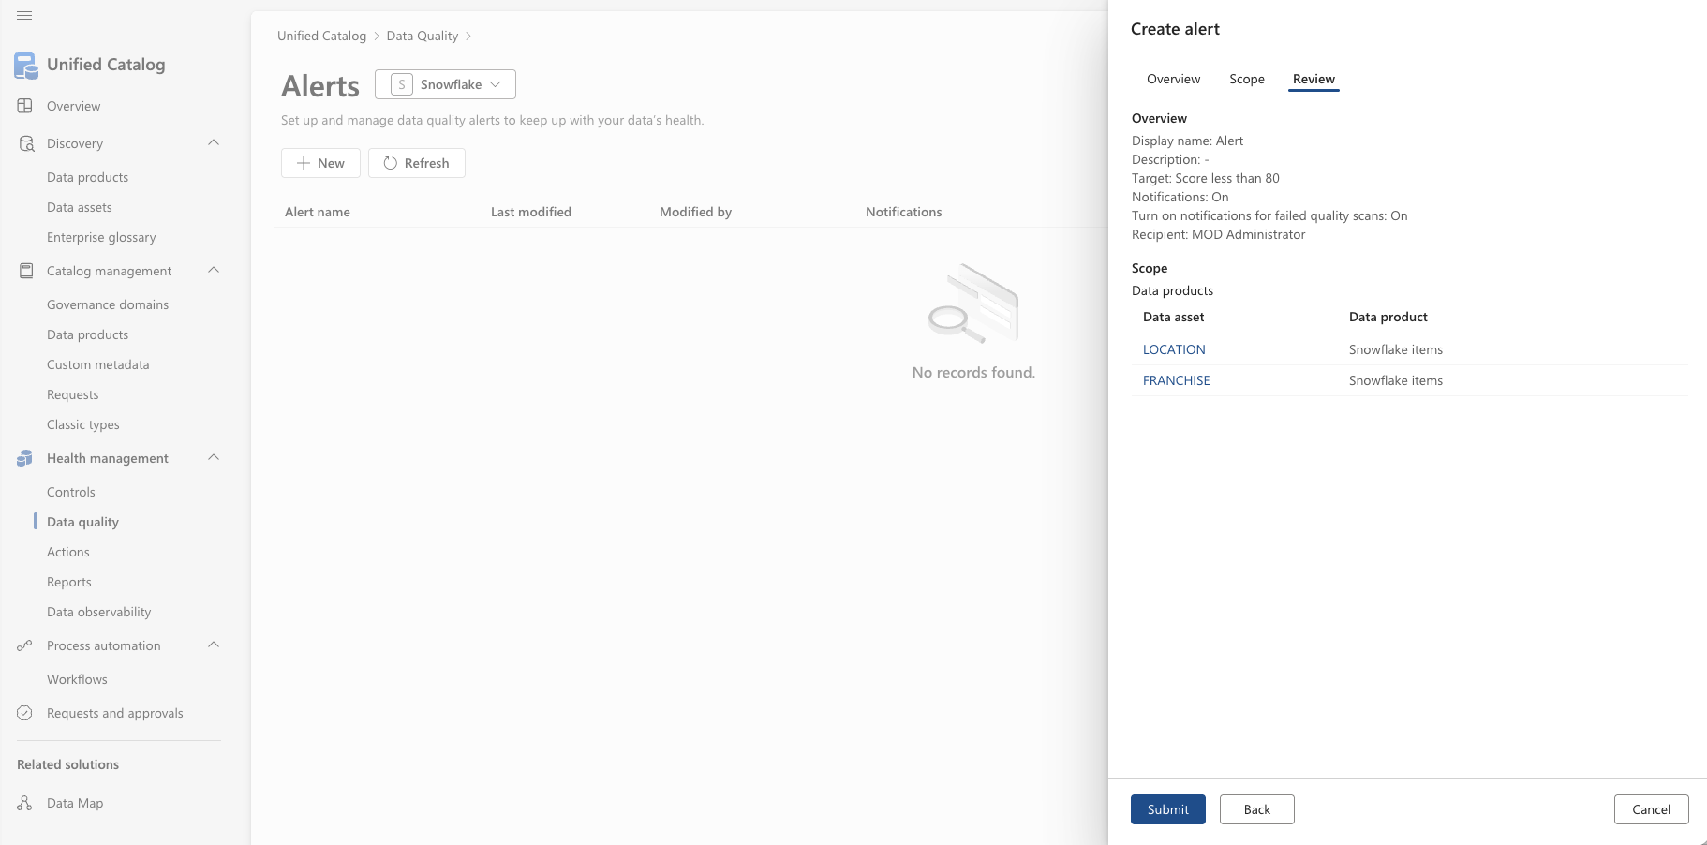

Slide 57
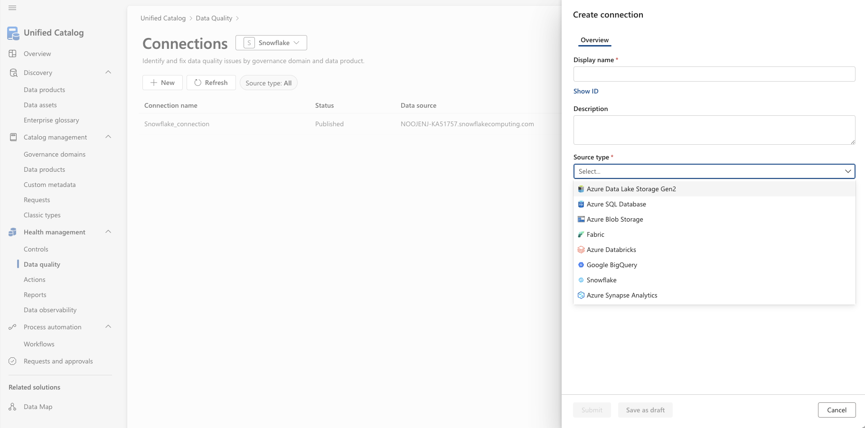

Slide 58
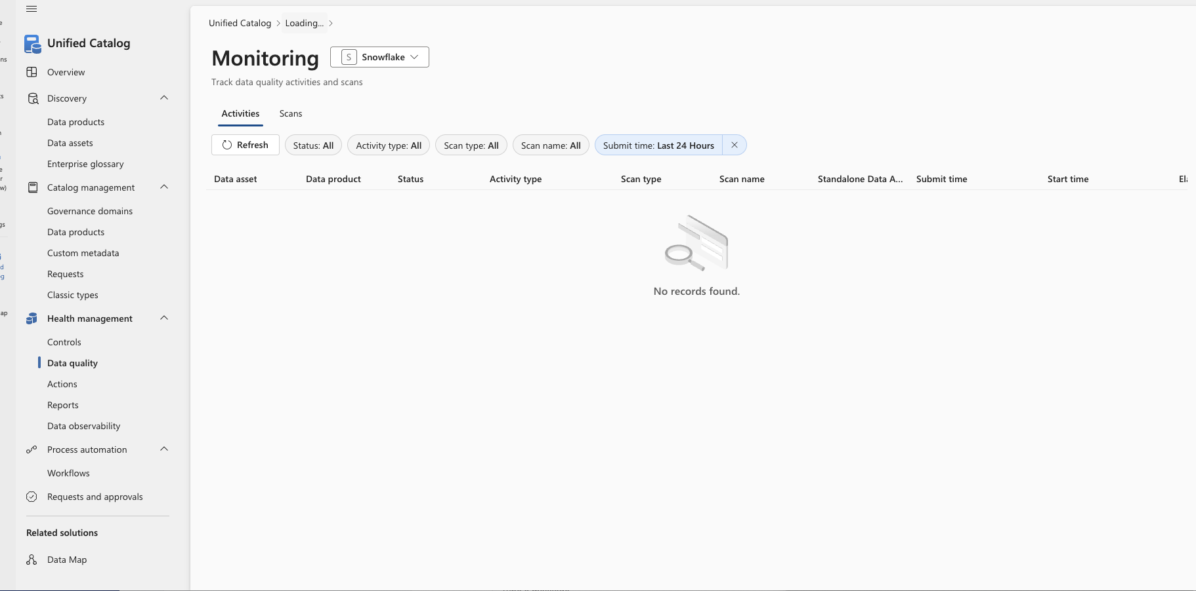

Slide 60
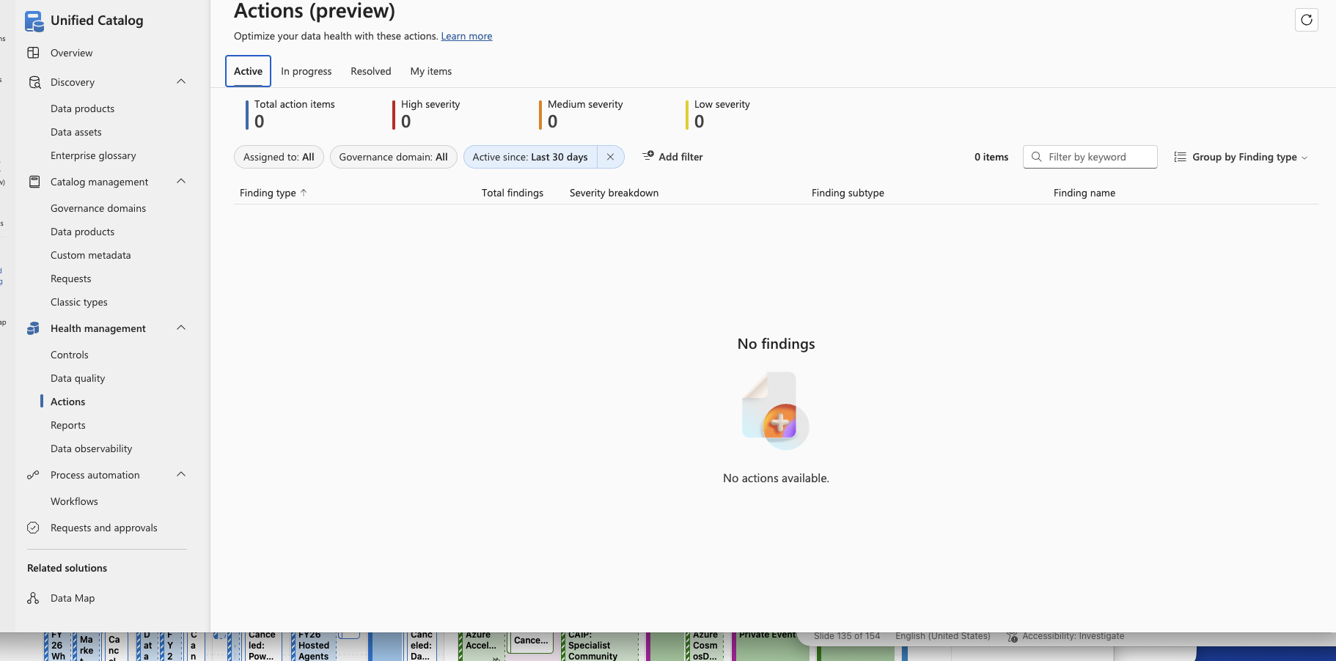

Slide 61
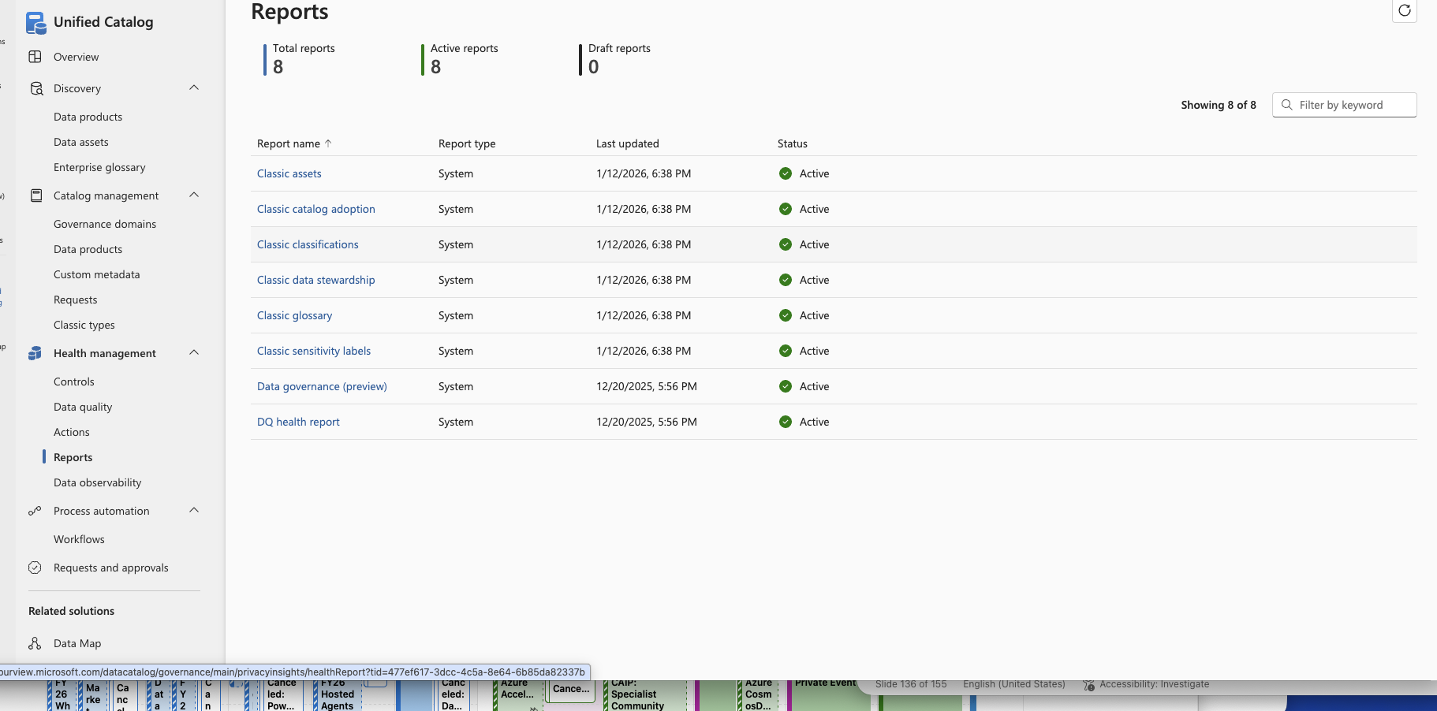

Slide 62
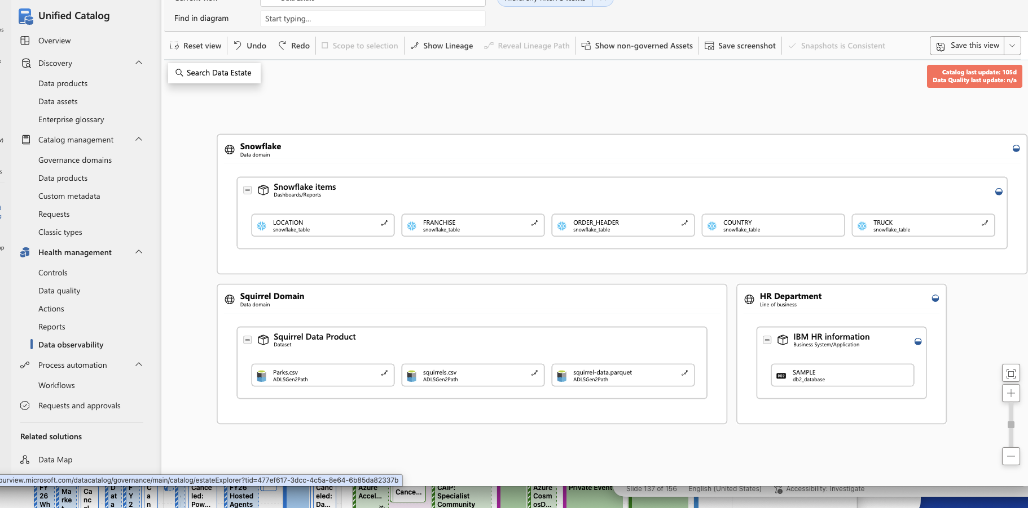

Slide 63
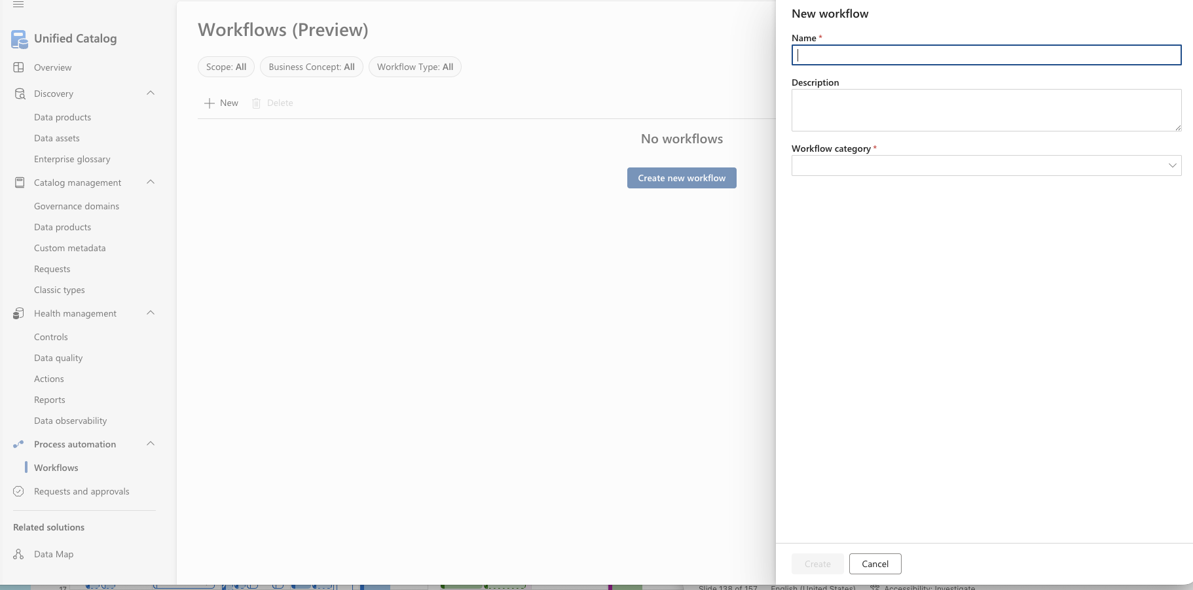

Slide 64


Slide 65
Data Quality

Slide 66


Slide 67


Slide 68


Slide 69


Slide 71


Slide 72


Slide 73


Slide 74


Slide 75


Slide 76


Slide 77


Slide 78


Slide 79


Slide 80


Slide 81


Slide 82
Policies

